Slide 1
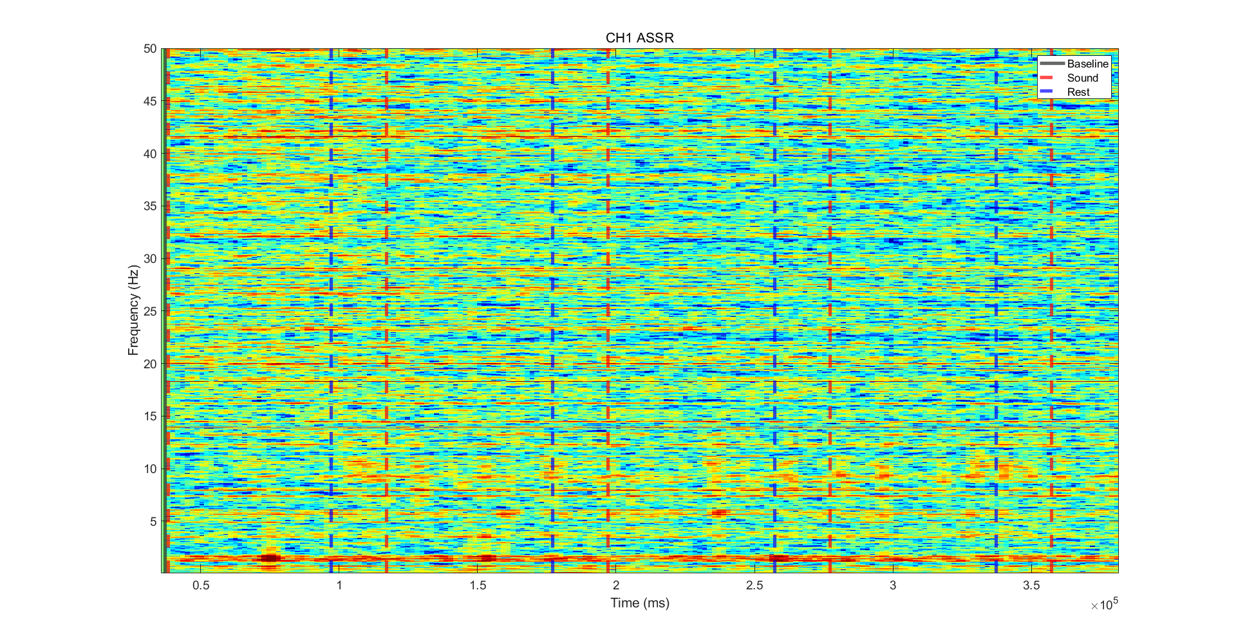

EEG Recording - ASSR
ASSR HPF 0.3Hz

Slide 2

EEG Recording - ASSR
ASSR FDR p=0.05

Slide 3
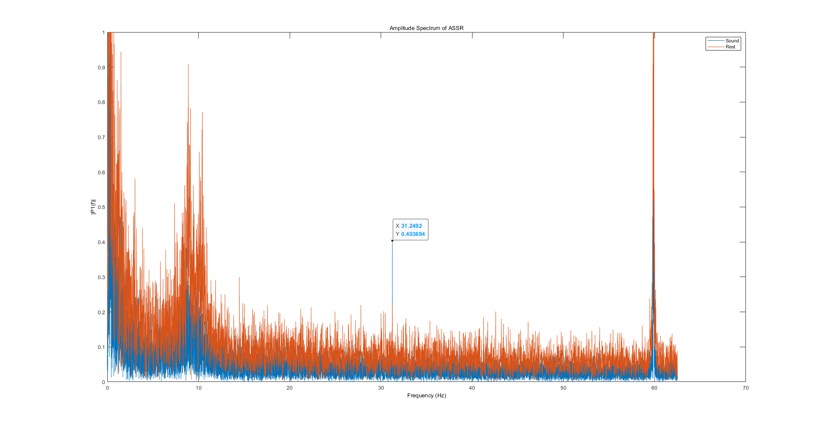
EEG Recording - ASSR
FFT

Slide 4
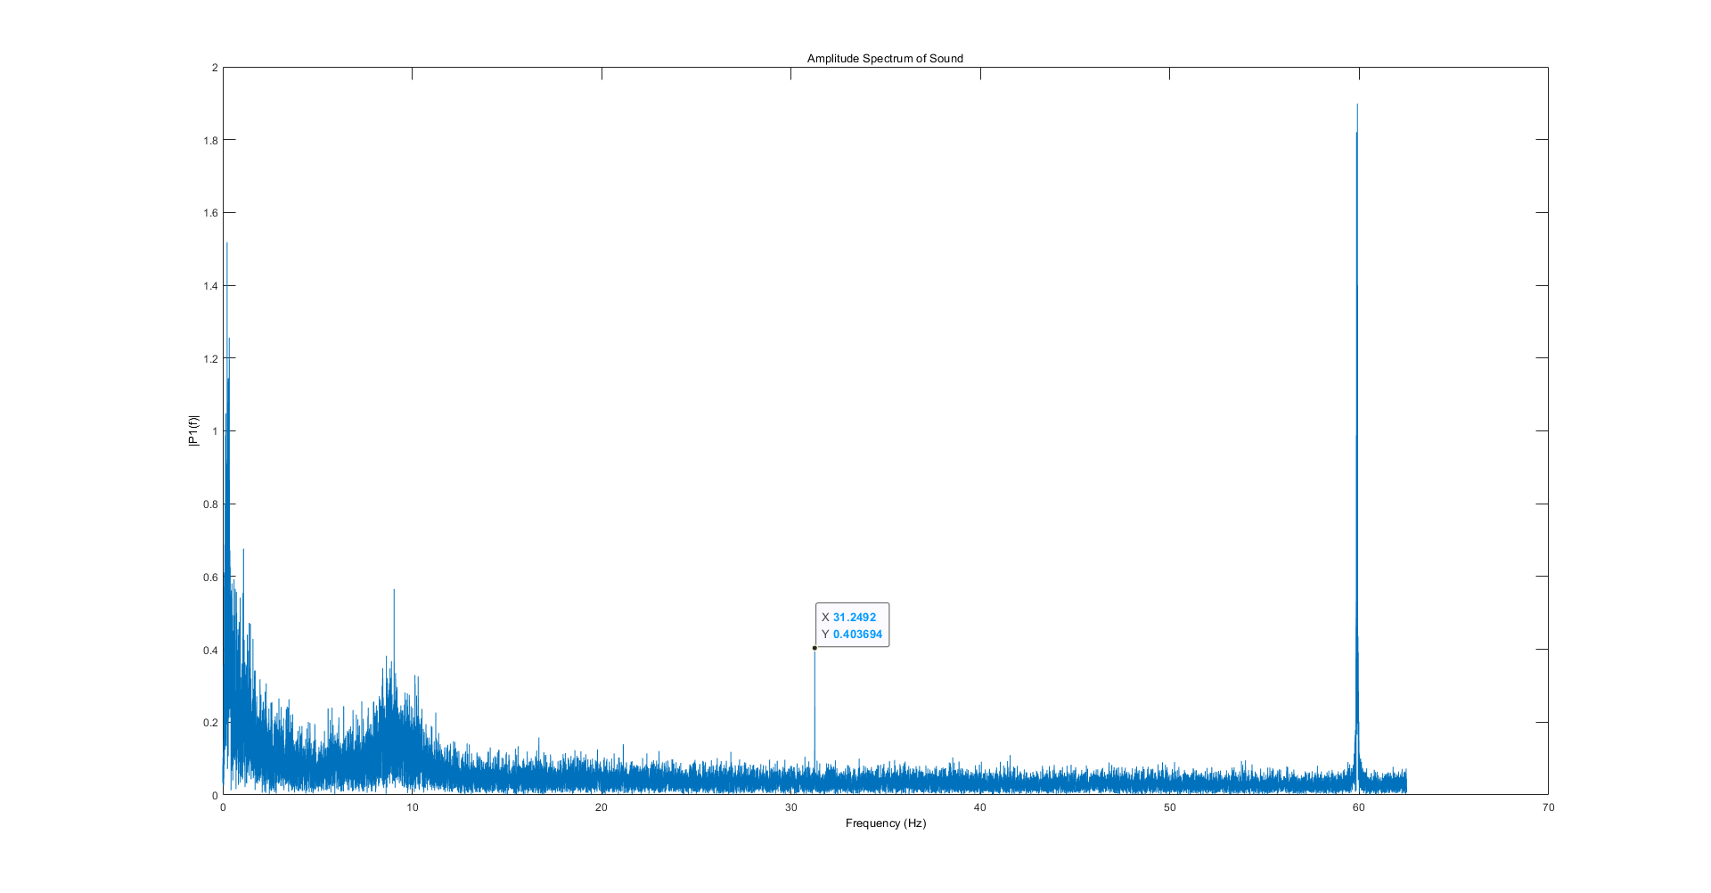
EEG Recording - ASSR
FFT

Slide 5
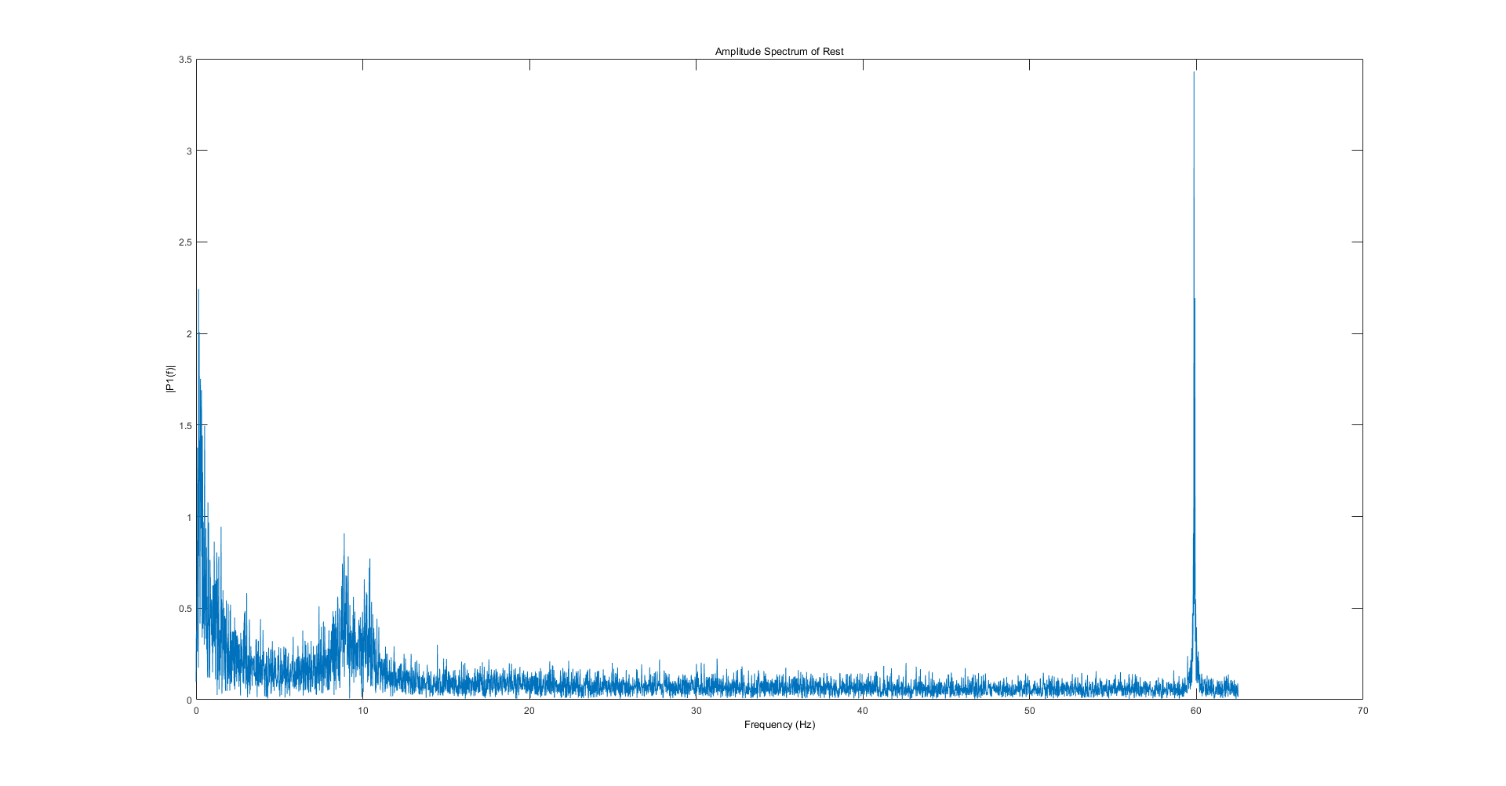
EEG Recording - ASSR
FFT

